Slide 1




TIP-ME
APP FOR EASY DIRECT TIPS
COMPLETE ANAYLSIS OF RESTAURANT TIPPING BEHAVIOR
Javier Martínez Ochoa

Slide 2
PROJECT INTRODUCTION
In many Europe countrys, tips are not mandatory, leaving consumers the opportunity to leave a small appreciation if they feel the service was satisfactory. However, this habit is becoming less common due to the increased use of card and mobile payments. This analysis addresses these issues and proposes a solution.

Slide 3
PROJECT OBJETIVES
First we are going to understand what is the issue with tipping and present a possible solution.
01 - ISSUE
In this part, the idea is to get a perspective of how users act when visiting restaurants and their overall experience.
02 - OVERALL
03 - BEHAVIOUR
Explore the tipping habits of the users and gain insights on how they behave.

Slide 4
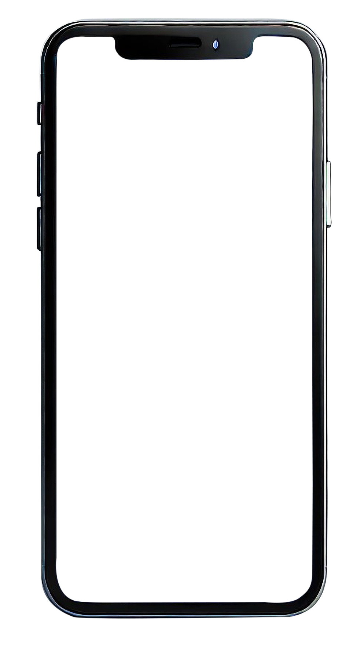
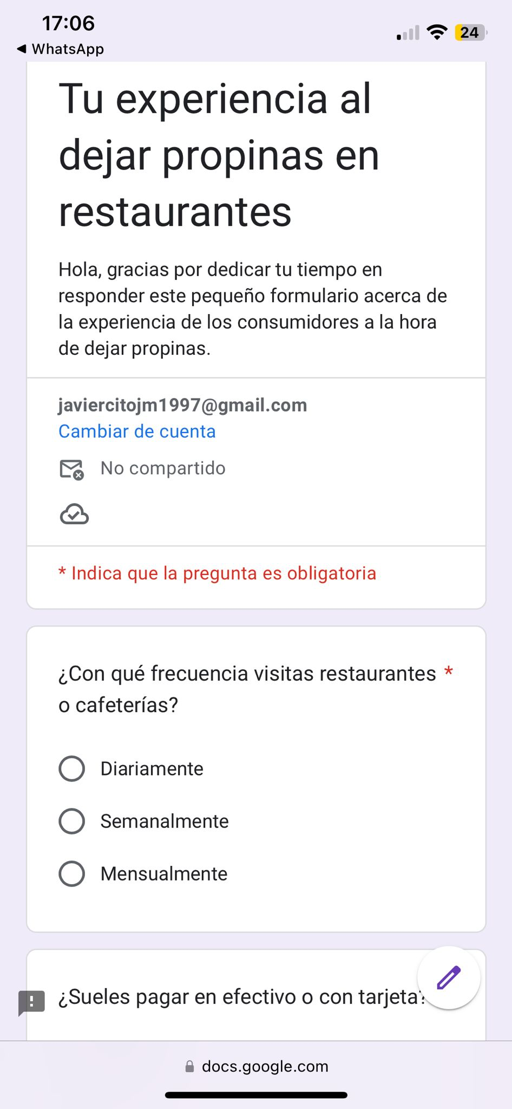
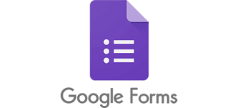
IMPLEMENTATION DETAILS
For the purpose of the analysis a survey was launched to get a perspective of how users behave and understand the key points we want to cover in this presentation. Total response: 52 answer

Slide 5
ISSUE
WHEN YOU ADD A TIP DIRECTLY TO THE RESTAURANT BILL, ARE YOU SURE THE MONEY GOES TO THE WAITER?
We asked our users, when paying with card and adding the tip to the bill, if they where sure their tip went to the waiter.

Slide 6
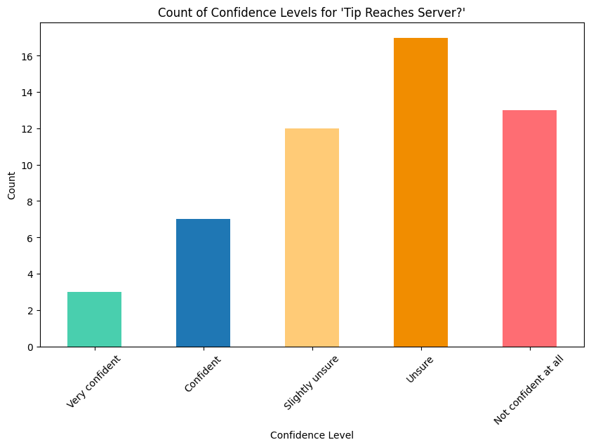
WHEN YOU ADD A TIP DIRECTLY TO THE RESTAURANT BILL, ARE YOU SURE THE MONEY GOES TO THE WAITER?
In this graphic we can see that most of our users are unsure if the tips go directly to the waiter.
Very confident
20%
Confident
02 - WEBSITE
Slightly unsure
Unsure
80%
Not confident at all

Slide 7
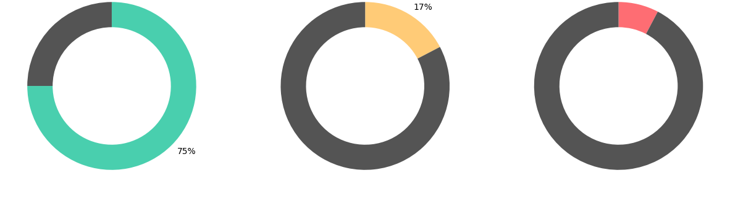
USER INTEREST IN A TIPPING APP
We asked our users if they would be interested in using an app that allows them to tip waiters directly.
75%
17%
7%
Yes
Unsure
No

Slide 8
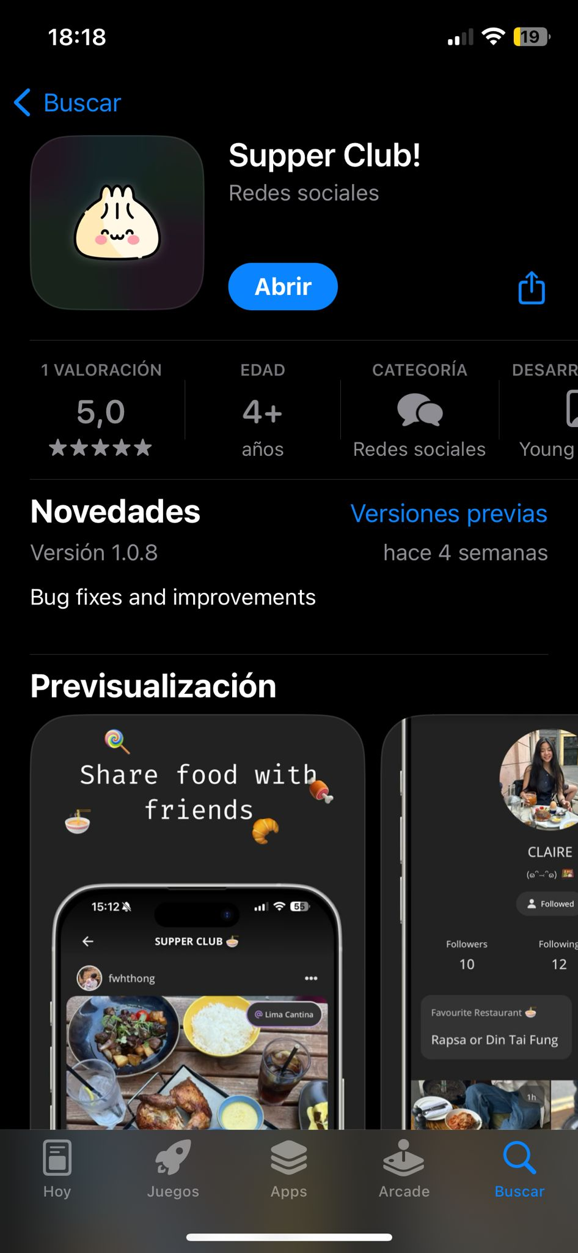
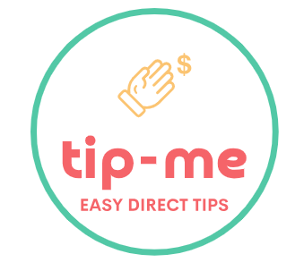
Tip-me Finanzas
With this app, you can easily and directly tip the waiters who serve you, with the confidence that they will receive their fair share.

Slide 9

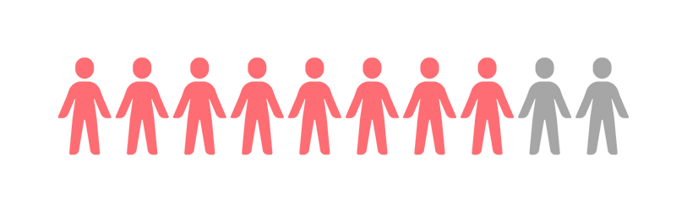
“It gives me confidence to know that the tip goes directly to the waiter, and above all, it provides the convenience of being able to pay directly with my card in a quick and simple way”.
8 OUT OF 10
"Understanding that the tip goes directly to the waiter’s account, without restaurant owners or managers having access to see tip amounts or influence the waiter’s salary."
Users are pleased
with the possibility of an app.

Slide 10
OVERALL
RESTAURANT EXPERIENCE
Understanding how the users behave is crucial for further analysis and to get and overall idea of the situation.

Slide 11
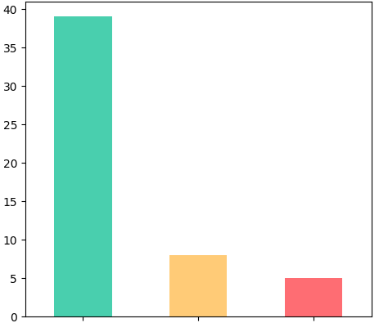
RESTAURANT EXPERIENCE
FREQUENCY OF VISITS
In this part of the analysis we are going to explain how users behave when going to restaurants and what there preferences they have regarding payment
Weekly
Daily
Monthly

Slide 12
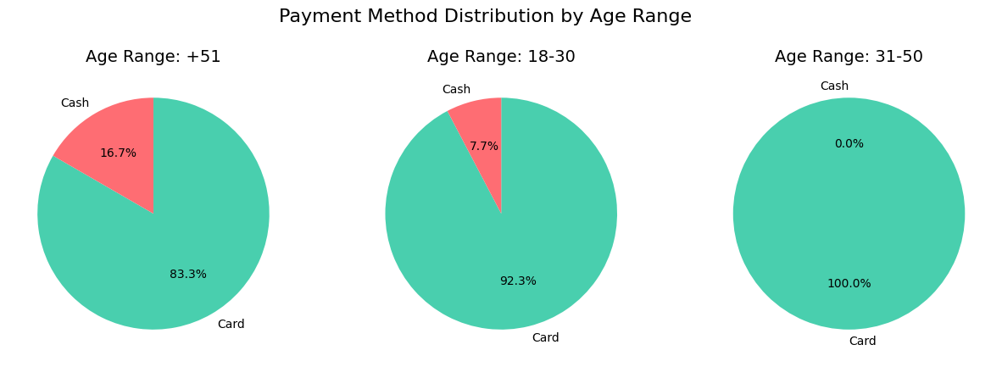
RESTAURANT EXPERIENCE
PAYMENT METHOD
16.7%
51+
The study shows that older people tend to pay more with cash than younger people meaning that people carry less cash nowadays.
83.3%
7.7%
Card
Cash
18-50
92.3%
01 - BRANDING
02 - WEBSITE
03 - SOCIAL MEDIA

Slide 13
BEHAVIOUR
USER TIPPING BEHAVIOR
How often do our users leave a tip? In this part of the analysis, we will explore user action regarding tipping to gain insights into their habits.

Slide 14
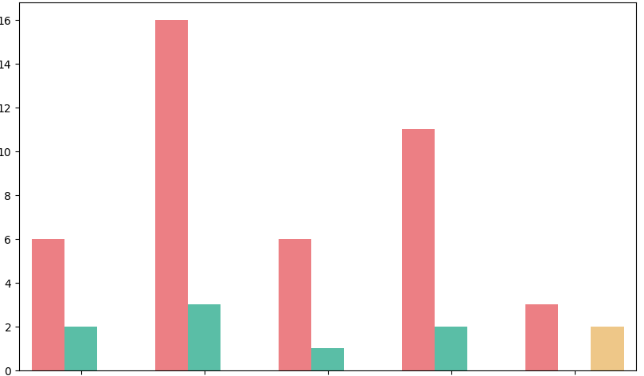
USER TIPPING BEHAVIOR
TIPPING PREFERENCE AND FREQUENCY
We can see that most of the users leave a tip and that cash is the preference of method for this action
Card
Cash
Other
How often do you leave tips?
Never
Rarely
Often
Sometimes
Always

Slide 15
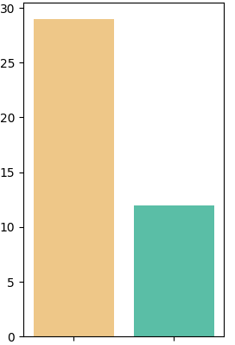
USER TIPPING BEHAVIOR
TIPPING AMOUNT RELATED TO AGE
All
(5%, 10%)
Percentage-based tips
(1$, 2$)
As we can see, most of our users prefer fixed amount tips, but it is important to note that older people tend to prefer percentage-based tips.
Fixed amount tips
Other
17%
22%
16%
17%
67%
61%
51+
18-50

Slide 16
The analysis suggests that digital payment methods are influencing tipping habits. Since cash payments are declining, it is essential that the app facilitates and promotes digital tipping.
CONCLUSIONS
While some users always leave a tip, others tip occasionally or rarely. This indicates an opportunity to further incentivize tipping through app rewards.
The analysis shows that users value the assurance that their tips are directly reaching the waiter. The app should emphasize this aspect to build user trust.

Slide 17
THANK YOU

